Slide 1
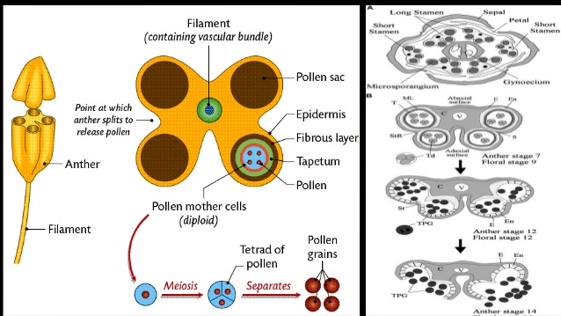
Anther Development

Slide 2
TS Tetrasporangiate Anther

Slide 3
Stages in development of Anther

Slide 4
T S young anther showing sporogenous cells

Slide 5
T S Anther lobe PMC undergoing meiosis

Slide 6
T S Anther lobe showing pollen tetrads and secretory tapetum

Slide 7
T S Mature anther

Slide 9
T S mature anther ready for dehiscence

Slide 10
T S Mature Anther ready for dehiscence

Slide 11
ANTHER LOBE SHOWING POLLEN GRAINS

Slide 12
T S Dehisced Anther

Slide 14
Compound pollen grains- Drimys, Drocera

Slide 15
Pollen grains of Mimosa –Polyads or Massulae

Slide 16
Pollinium- Orchidaceae, Asclepiadaceae

Slide 17
Pollinium in Calotropis

