Slide 1
AEROBICS TRAINING
SEMESTER 3
PHYSICAL EDUCATION
By
Dr. AMITA HANDA
Shivaji College
University of Delhi

Slide 2
UNIT 1: INTRODUCTION
INTRODUCTION TO AEROBICS
BENEFITS OF PARTICIPATION IN AEROBICS
EVOLUTION OF AEROBICS
INDIVIDUALIZED AND GROUP TRAINING IN AEROBICS

Slide 3
AEROBICS: INTRODUCTION
Aerobic means in the presence of oxygen.
low to moderate level of exercise and can be sustained over long periods.
Improving all elements of fitness .
It strengthens the heart and lungs and trains the cardiovascular system.
Is rhythmic in nature.
Examples are walking, jogging, running, cycling, rowing, cross-country skiing, skipping and hiking.

Slide 4
DEFINITION OF AEROBICS
Any of various sustained exercises, as jogging, rowing, swimming, or cycling, that stimulate and strengthen the heart and lungs, thereby improving the body's utilization of oxygen.
The use of oxygen to adequately meet energy demands during exercise.
Is a form of physical exercise that combines rhythmic exercise with stretching and strength training routines with the goal of improving all elements of fitness (flexibility, muscular strength, and cardio-vascular fitness).

Slide 5
KIND OF AEROBICS
Low Impact Aerobics: At least one foot stays in contact with the ground at all times ,Recommended for one with health issues, works the body's muscles and increases heart rate, without the additional strain to your joints.
High Impact Aerobics: Improve fitness component & skill. both the feet leave the ground, can put stress on your bones and joints
Others: Aqua/water Aerobics, step Aerobics, weight Aerobics, Floor Aerobics.

Slide 6
IMAGES OF AEROBIC EXERCISE

Slide 7
BENEFIT OF AEROBICS
Improves blood circulation and helps the body use oxygen better.
Increases energy.
Increases endurance.
Helps reduce the risk of developing heart disease.
Helps reduce the risk of developing other lifestyles diseases.

Slide 8
BENEFIT OF AEROBICS
Maintain a healthy weight.
Helps reduce stress, tension, anxiety, and depression.
Improves sleep.
Activates immune system.
Builds the muscular strength and makes your body more flexible.

Slide 9
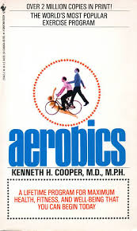
EVOLUTION OF AEROBICS
Dr. Kenneth H. Cooper( 1968), published his book ‘Aerobics’ in USA.
Notes:
Dr. Kenneth Cooper(1960), an exercise physiologist based in the San Antonio Air Force Hospital, Texas. searched for an effective and easy way of keeping healthy. He sent a powerful message to the American people: To prevent the development of chronic diseases, one must exercise regularly and maintain a high level of fitness throughout one’s life. This system was originally intended for the military but later on open to general public.

Slide 10
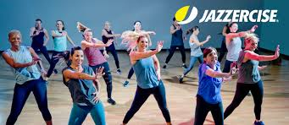
EVOLUTION OF AEROBICS
Jazzercise (1969) Judi Sheppard Missett founded the dance-based fitness program.
Its franchise continues to grow today.
Notes:
Today she runs a fitness company in California, United States as CEO and Founder. Her daughter, Shanna Missett Nelson, is the President and an instructor
High intensity program. Includes cardio, strength and stretch moves, hip-hop, jazz dance, kickboxing, resistance training and yoga for a total-body workout.

Slide 11
EVOLUTION OF AEROBICS
Aerobics Dance by Jacki Sorensen
(1970s)
Aerobics fitness studio by Richard Simmons
(1970s)
Notes:
Jacki Sorensen is credited with taking Dr. Cooper's knowledge and synthesizing it into effective aerobic workout routines.
Following his own weight-loss experience, Simmons opened an exercise studio named "The Anatomy Asylum”, where eating reasonable portion sizes and performing proper exercise was emphasized. Simmons has produced dozens of aerobic-workout videos. Later Simmons disappeared from the public eye in February 2014.

Slide 12
EVOLUTION OF AEROBICS
Workout exercise by Jane Fonda (1982)
Aerobics gained worldwide popularity after the release of her exercise videos in 1982.
Notes:
Fonda: enabled millions of people to exercise within the confines of their own homes. Perhaps most important is that people have been able to pursue fitness in a comfortable environment at a level best suited to their individual needs.

Slide 13
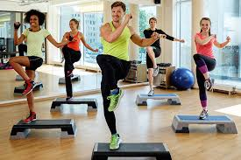
EVOLUTION OF AEROBICS
Step Aerobics by Gin Miller (1980s)
Notes:
After a knee injury, Miller consulted an orthopedic doctor, who recommended she strengthen the muscles supporting the knee by stepping up and down on a milk crate; from this she developed the step regimen.

Slide 14
EVOLUTION OF AEROBICS
Tae Bo by Billy Blanks (1990s):a new cardio-boxing aerobic exercise effective for weight loss.
Pilates by Joseph Pilates in Germany (1990s)
Swiss (Stability) Ball (1990s) by an Italian plastics manufacturer, Aquilino Casani.
First world championships at San Diego in March 1990.
Notes:
Tae Bo is a combination of dance, martial arts and boxing moves designed to improve cardiorespiratory and muscle fitness. classes were created and taught in health facilities and studios around the world.
While Joe is the man behind the method, it was his wife Clara that became the real teacher in the studio. the six Pilates principles are centering, control, flow, breath, precision and concentration.
SWISS BALL was primarily used by physiotherapists for various therapeutic applications and orthopaedic problems. Over the past 30 years, stability balls have gradually transitioned from the clinical environment to the mainstream fitness setting. Presently, it is incorporated into yoga, Pilates, balance training, core exercises and various other fitness programs.

Slide 15
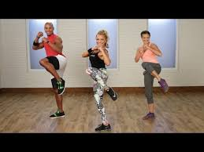
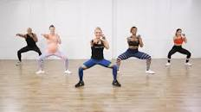
EVOLUTION OF AEROBICS: IMAGES
Cardio-boxing aerobic exercise:

Slide 16
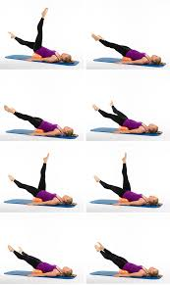
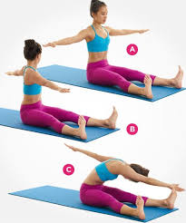
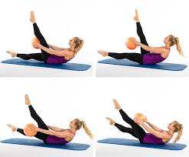
EVOLUTION OF AEROBICS: IMAGES
Pilates:

Slide 17
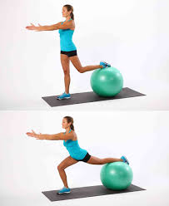
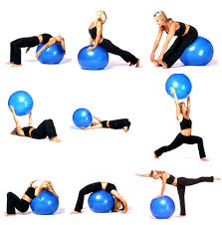
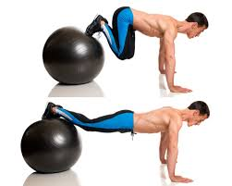
EVOLUTION OF AEROBICS: IMAGES
Swiss (Stability) Ball Exercise:

Slide 18
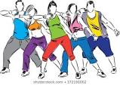
EVOLUTION OF AEROBICS
Zumba (1999) in Columbia by Albert ‘Beto’ Perez.
Notes:
he accidentally forgot the aerobics music for a class. Perez quickly grabbed the only other music he could find in his car—traditional Latin salsa—and a new fitness movement was born. Perez brought his dance-fitness program, with elements of hip-hop, salsa, martial arts and calisthenics,

Slide 19
EVOLUTION OF AEROBICS
21st Century Aerobics
Competitive/ sports aerobics came into existence.
Improved with technology.
Notes:
15 countries participated in first world championship. In 1996. Scoring is by judging of artistic quality, creativity, execution, and difficulty of routines. Sport aerobics has state, national, and international competitions, but is not an Olympic sport.
there are apps available for download that show you how to do exercises and guide you through a workout.

Slide 20
Training in Aerobics
Types of training in Aerobics:
Individual training
Group Training
Training in Aerobics is characterized by :
setting objectives
teaching content based on these objectives.
evaluating performance.

Slide 21
INDIVIDUALIZED TRAINING IN AEROBICS
INTRODUCTION
Personalized supervision from your trainer.
Is a specialist and will cater to specific needs.
personal trainers to have credible certifications.
Quickly and effectively getting into shape.
Think of it only when you have some serious fitness goals to achieve.
Effective if suffering from an injury or a delicate health condition.
Notes:
2. For example, if a trainer is great at core training, he may have limited knowledge about yoga training.
3. they are usually specialised in the domain that they teach in.

Slide 22
INDIVIDUALIZED TRAINING IN AEROBICS
The advantages are:
Desired time
Desired pace
Self-discipline
Healthy lifestyle
learning styles
Take less time to get a proper workout in.
Close supervision and safety.
More Concentration
Notes:
Training at the preferred time, before work, after work as per convenience.
Pace: You have developed a routine and stick to it. Nobody tells you what to do, and that can be very liberating during training.
You independently integrate your workouts into your everyday life, thereby strengthening your self-discipline and self-responsibility. You learn to stick to it and start your training without external motivation.
Healthy lifestyle: You shape your everyday life in such a way that you reach your fitness goal.
Any Learning style: to treat a long or short term injury, lose weight, get in tip-top shape or train for a specific event, or sport.
Alone you can often concentrate better.

Slide 23
INDIVIDUALIZED TRAINING IN AEROBICS
The disadvantages are:
Excuses
Feedback
Fun factor
There is a long lead time to prepare materials.
Lack of external motivation.
The trainer’s role needs to change.
Notes:
there are many excuses to cancel or shorten your workout.
If you don’t get enough feedback from others, mistakes creep into your movement sequences.
Monotony can have a negative effect on training quality.

Slide 24
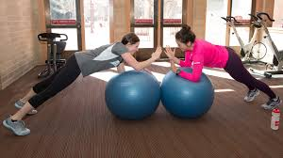
INDIVIDUALIZED TRAINING IMAGES

Slide 25
GROUP TRAINING IN AEROBICS
INTRODUCTION
works when groups are smaller.
Ineffective in large groups.
Infrastructure.
Music selection.
Coach decides the sequence of workout.
Fixed timing.
Fixed Pace

Slide 26
GROUP TRAINING IN AEROBICS
Advantages are:
Feedback
Impulses
Responsibility
Structured Planning
versatility
It can be a pleasant, fulfilling experience.
Motivation and encouragement.
there is a sense of moral support.
Notes:
Experienced athletes can get impulses from group members to become fitter or improve their training routine.
help you develop a strong sense of responsibility to stay in shape.
can stick to a more structured training plan. Fixed training times form a weekly structure that can help you maintain and develop your training routine.
develop your skills in different directions.

Slide 27
GROUP TRAINING IN AEROBICS
Disadvantages are:
Distraction
Group size
Characters of the group
One size fits all
Notes:
The quality of the training can suffer from conversations.
If the group is too big, you will be lost in the crowd and feedback will not reach you as often.
Negative vibrations between trainees can have a negative effect on the flow of training.
does not take into account the personal goals of each individual

Slide 28
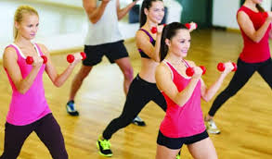
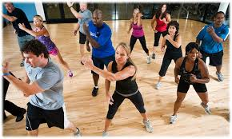
GROUP TRAINING IMAGES

Slide 29
AEROBICS TRAINING: CONCLUSION
An ideal training design of aerobics depends on the goal and personality of learner .
One can progress from a combination of individual training and group training.

