Slide 1
International Bank for Reconstruction and Development
( world bank)

Slide 4
Introduction

Slide 5
ORGANISATION STRUCTURE

Slide 6
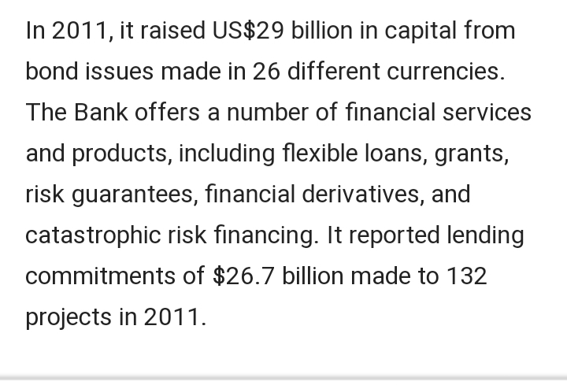

Slide 7
SERVICES OF IBRD

Slide 8
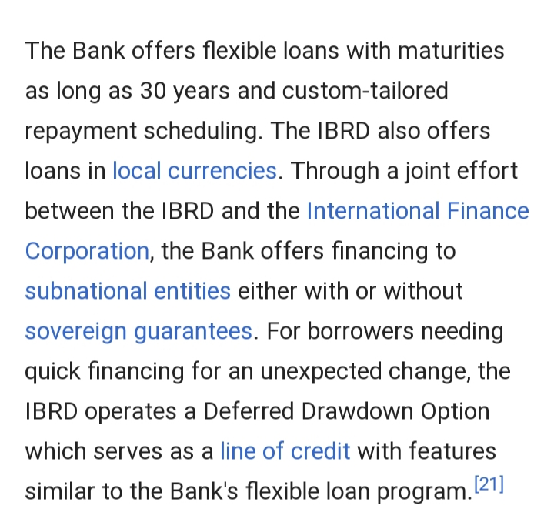

Slide 9
RECENT WORK

