Slide 1
Pollination
Pollination is the transfer of pollen from a male part of a plant to a female part of a plant, later enabling fertilization and the production of seeds. It is of two types:
Self Pollination or autogamy
Cross Pollination or Allogamy : there are two types
A Xenogamy – Different Plants
B Geitonogamy – Same plant

Slide 2
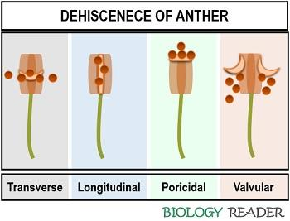

Slide 3
Types of Dehiscence
Transverse dehiscence: In this, pollen releases away from the centre of the unilocular anther.
Example: Members of the Malvaceae family.
Longitudinal dehiscence: Here, the pollen releases laterally or longitudinally, neither towards nor away from the axis.
Example: Datura
Poricidal dehiscence: In this type, pollen releases from the apical or distal region.
Example: Potato, Brinjal etc.
Valvular dehiscence: In this type, the anther wall opens like trap doors from where the pollen releases.
Example: Berberries, Laurus etc.

Slide 4
Which Flowers self pollinate
Both hermaphrodite and monoecious species have the potential for self-pollination leading to self-fertilization unless there is a mechanism to avoid it. Eighty percent of all flowering plants are hermaphroditic, meaning they contain both sexes in the same flower, while 5 percent of plant species are monoecious. The remaining 15% would therefore be dioecious (each plant unisexual). Plants that self-pollinate include several types of orchids, and sunflowers. Dandelions are also capable of self-pollination as well as cross-pollination

Slide 5
Factors affecting self pollination
Bisexuality
Homogamy
Cleistogamy seen in peanuts, peas and Viola
Bud Pollination in peas and grass family

Slide 6
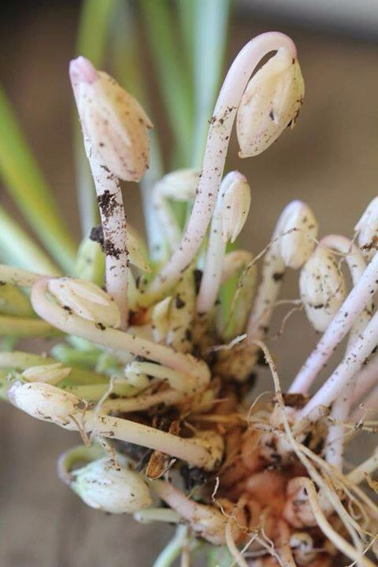
Viola flower can be both – chasmogamous and cleistogamous

Slide 7
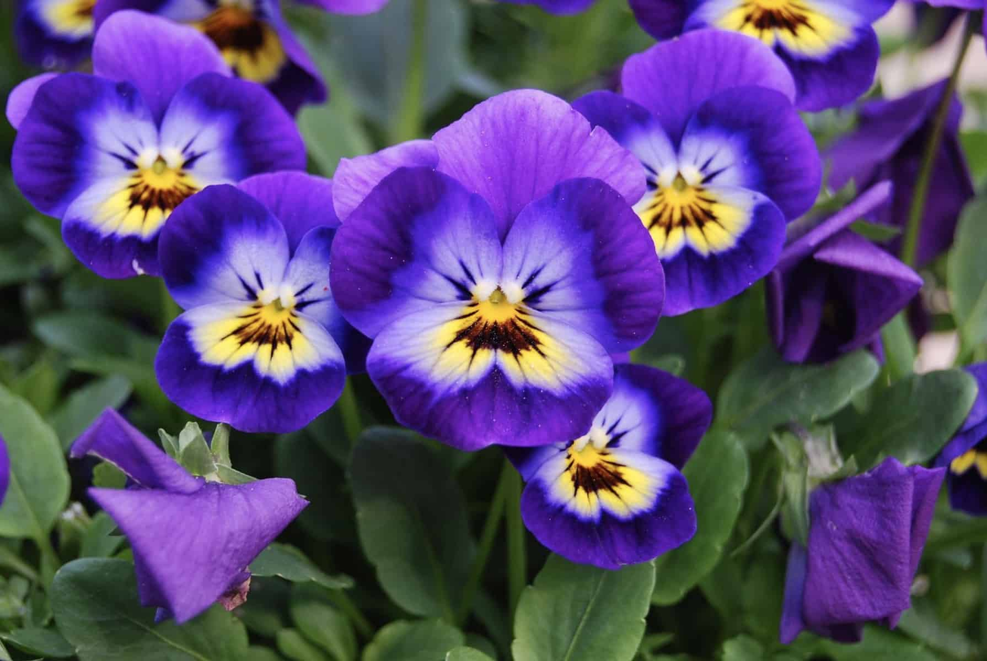
Chasmogamous flowers of Viola

Slide 8
Advantages of Self Pollination
There are several advantages for self-pollination.
Firstly, if a given genotype is well-suited for an environment, self-pollination helps to keep this trait stable in the species.
Not being dependent on pollinating agents allows self-pollination to occur when bees and wind are nowhere to be found.
Self-pollination can be an advantage when the number of flowers is small or they are widely spaced. During self-pollination, the pollen grains are not transmitted from one flower to another. As a result, there is less wastage of pollen,
They also cannot make changes in their characters and so the features of a species can be maintained with purity.
Self-pollination also helps to preserve parental characters as the gametes from the same flower are evolved.
It is not necessary for flowers to produce nectar, scent, or to be colourful in order to attract pollen.

Slide 9
Disadvantages of self-pollination
The disadvantages of self-pollination come from a lack of variation that allows no adaptation to the changing environment or potential pathogen attack. Self-pollination can lead to inbreeding depression caused by expression of deleterious recessive mutations or to the reduced health of the species, due to the breeding of related specimens. This is why many flowers that could potentially self-pollinate have a built-in mechanism to avoid it, or make it second choice at best. Genetic defects in self-pollinating plants cannot be eliminated by genetic recombination and offspring can only avoid inheriting the deleterious attributes through a chance mutation arising in a gamete.

Slide 10
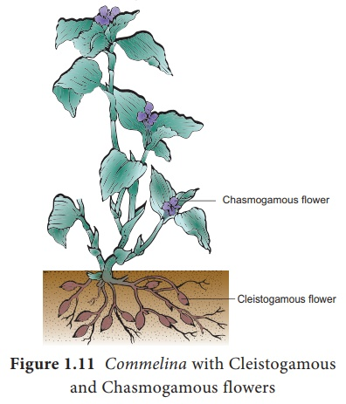
Commelina benghalensis shows both cleistogamous and Chasmogamous flowers

Slide 11
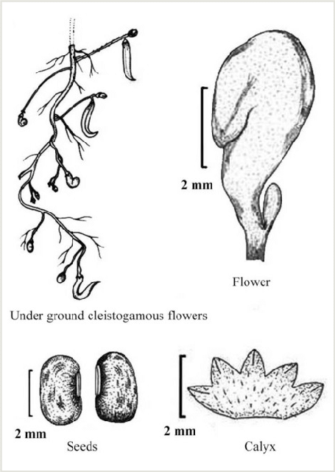
Cleistogamy in Vigna

Slide 12
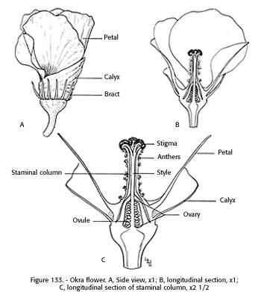
Pollination in Okra

Slide 13
Floral Mechanisms favouring Cross Pollination
Self Sterility or self incompatibility eg Petunia axillaris
Dichogamy:
Protandry eg Saxifraga and Impatiens
Protogyny eg Aristolochia
Herkogamy eg Caryophyllaceous flowers
Heterostyly
Distyly in Primula vulgaris (pin and thrum eyed flowers)
Tristyly in Lythrum and Oxallis

Slide 14
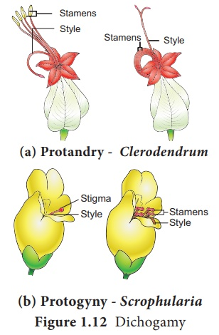
Dichogamy

Slide 15
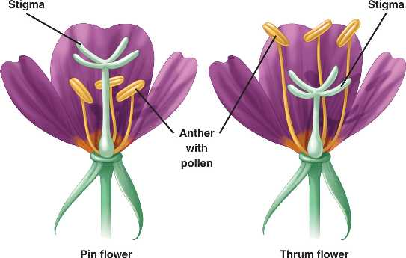
Cross Pollination in Primula - Distyly

Slide 16
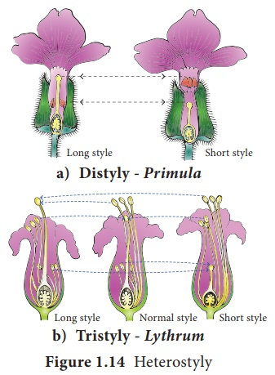
Distyly and Tristyly

Slide 17
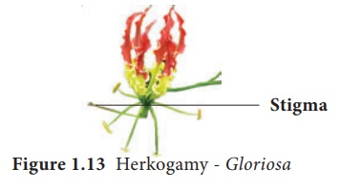
Herkogamy: In bisexual flowers the essential organs, the stamens and stigmas, are arranged in such a way that self-pollination becomes impossible.
For example in Gloriosa superba, the style is reflexed away from the stamens and in Hibiscus the stigmas project far above the stamens

Slide 18
Advantages of Cross Pollination
Offsprings produced are healthier
New varieties can be produced through cross-pollination of two varieties of the same species or two species
Seeds that are produced are abundant and viable

Slide 19
Disadvantages of Cross Pollination
It is not always certain as a pollinating agent is always required, and it may or may not be available at the suitable time.
Pollen grains have to be produced in abundance to ensure chances of pollination.

Slide 20
Pollen Storage
Dry and Cold Storage
Cryogenic Storage
Organic Sovents

Slide 21
Pollen Viability tests
Seed set or ovule development after pollination
Pollen germination and pollen tube growth
In vitro pollen germination
Tetrazolium chloride test
Fluorescein diacetate test
NMR method

Slide 22
References
https://owlcation.com/stem/6-Agents-of-Pollination
https://www.youtube.com/watch?v=SqjPJQvsYy8

