Slide 1
Ritu Meena
Assistant Professor
Shivaji Collage
Course-B.Sc.(APS)Computer Science
Semester - VI
Paper- Android Programming

Slide 2
SQLite Database
SQLite database is in built into every android device
SQLite database is a base class, which provide methods open(), close(), insert(), update(), delete().
execSQL() method used to execute sql statements
Data/data/app-name/databases/filename default directory in which database is saved.

Slide 3
Creating Database and Tables
To Create and upgrade a database in your Android application you create a subclass of the SQLiteOpenHelper class. In the constructor of your subclass you call the super() method of SQLiteOpenHelper
Create ->empty activity
App folder ->java folder-> Right click on Package-> create new java class -> DatabseHelper.java

Slide 4
SQLite Example
DatbaseHelper.java file
private static class DatabaseHelper extends SQLiteOpenHelper {
Public static final String DATABASE_NAME = “student.db”;
Public static final String TABLE_NAME = “student_table”;
Public static final String COL_1 = “Std_ID”;
Public static final String COL_2 = “Name”;
public static final String COL_3 = “Marks”;
  DatabaseHelper(Context context) {
  super(context, DATABASE_NAME, null, DATABASE_VERSION);
  SQLiteDatabase db = this.getWritableDatbase();
  } //after call this method database is created

Slide 5
  @Override
  public void onCreate(SQLiteDatabase db) { db.execSQL(“create table” + TABLE_NAME +”(Std_ID INTEGER PRIMARY KEY AUTOINCREMENT, NAME TEXT, MARKS INTEGER)”);
  }
  @Override
  public void onUpgrade(SQLiteDatabase db, int oldVersion, int newVersion) {
  db.execSQL("DROP TABLE IF EXISTS “+TABLE_NAME);
  onCreate(db);
  }
  }

Slide 6
MainActivity.java file
DatabaseHelper mydb; //create object of DatabaseHelper class
Protected void onCreate(Bundle savedInstanceState){
Mydb = new DatabseHelper(this);

Slide 7
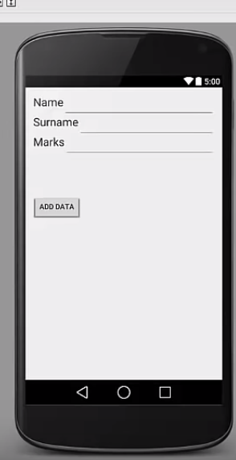
Insert values to SQLite Database table using Android

Slide 8
Continue with DatabaseHelper.java…….(slide no5)
  public void onUpgrade(SQLiteDatabase db, int oldVersion, int newVersion) {
  db.execSQL("DROP TABLE IF EXISTS “+TABLE_NAME);
  onCreate(db);
  }
  Public boolean insertData(String Std_ID, String name, String marks){
  SQLiteDatabase db = this.getWritableDatbase(); //we can remove this line from slide no 4
  ContentValues contentvalues = new ContentValues();
  contentvalues.put(COL_2, name);
  contentvalues.put(COL_3, marks);
  long result = db.insert(TABLE_NAME,null,contentvalues);
  If (result == -1)
  return false;
  else
  return false
  }}

Slide 9
In MainActivity.java file
Create 3 EditText and a Button name adddata
EditText editName = findViewById(R.id. editName);
EditText editMarks = findViewById(R.id. editMarks);
EditText editID= findViewById(R.id. editID);
Public void gotoActivity(){ \\on Click method
boolean isInserted = mydb.insertData(editName.getText().toString(), editID.getText().toString(),
editMarks.getText().toString());
}
If (isInserted == true)
Toast.makeText(MainActivity.this,”data Inserted”,Toast.LENGTH_LONG).show();
else
Toast.makeText(MainActivity.this,”data not Inserted”,Toast.LENGTH_LONG).show();

Slide 10
References
https://developer.android.com/training/data-storage/sqlite

